Slide 1


Breathing Easy: Air Quality Prediction using Regression Analysis
Applied Machine Learning
Sahil Wani
Mahitha Chennamadhava
Sai Sisira Pathakamur
Garvaa Jamsran
Pavan Kumar Reddy Katasani

Slide 2

Problem Statement
Air pollution is a major health hazard and can have serious consequences on human health. The World Health Organization reports that outdoor air pollution causes 4.2 million premature deaths worldwide every year.
Our objective is to analyze air quality data and identify patterns and trends that can help local authorities make informed decisions to improve air quality and reduce its negative effects on the city's residents and environment.

Slide 3
Data Collection and Analysis
The dataset contains 9358 instances of hourly averaged responses from an array of 5 metal oxide chemical sensors embedded in an Air Quality Chemical Multisensory Device. The device was located on the field in a significantly polluted area, at road level, within an Italian city. Data were recorded from March 2004 to February 2005 (one year) representing the longest freely available recordings of on field deployed air quality chemical sensor devices responses
Attributes:
Date (DD/MM/YYYY)
Time (HH.MM.SS)
CO(GT) True hourly averaged concentration CO
PT08.S1(CO) Hourly averaged sensor response for CO
NMHC True hourly averaged overall Non-Metanic Hydrocarbons concentration
C6H6(GT) True hourly averaged Benzene concentration
PT08.S2(NMHC) Hourly averaged sensor response for NMHC
NOx(GT) True hourly averaged NOx concentration
PT08.S3(NOx) Hourly averaged sensor response for NO
NO2(GT) True hourly averaged NO2 concentration
PT08.S4(NO2) Hourly averaged sensor response for NO2
PT08.S5(O3) Hourly averaged sensor response for O3
T Temperature in Â°C
RH Relative Humidity (%)
AH Absolute Humidity

Slide 4
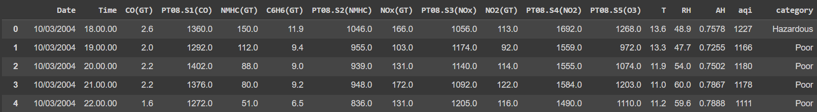
Data Summary:
The range of the target variable is between 0.198 and 2.231 with a mean of 1.023 and a standard deviation of 0.395.
Handled missing data with help KNN imputation.

Slide 5
Missing Data
In the data NA values were represented as -200
Dropping rows with all NAN column values
We used KNN imputers for missing values
WHY KNN ??
Dropping NAN resulted in 90% data loss, filling NAN resulted in unintentional alteration of data.
Linear interpolation is not suitable for complex time series patterns like cyclical/seasonal patterns.
KNN imputation is a non-parametric method that uses the values of the k-nearest neighbors to estimate the missing values.
It works for structured datasets, and is resistant to outliers and noise.

Slide 6
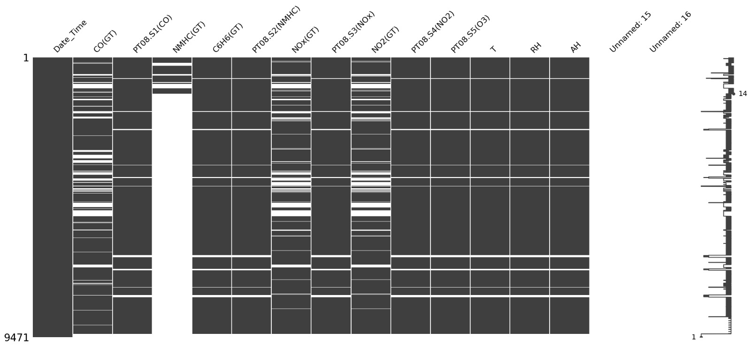
Missing value

Slide 7
Target Variable:
The hourly air quality index, represented by the AQI
Concentration of pollutants is the key factor in predicting the air quality index (AQI).
AQI is calculated based on five major pollutants, including PM2.5, PM10, O3, NO2, SO2, and CO.
Accurate measurement and monitoring of pollutant concentrations are crucial in predicting the AQI.

Slide 8
Target Variable continued..
AQI formula used:
AQI = [(Ipm10/ Bpm10) + (Ipm2.5/ Bpm2.5) + (Io3/ Bo3) + (Ino2/ Bno2) + (Iso2/ Bso2)]
Ipm10, Ipm2.5, Io3, Ino2, and Iso2 are the AQI values for PM10, PM2.5, O3, NO2, and SO2 respectively.
Bpm10, Bpm2.5, Bo3, Bno2, and Bso2 are the corresponding breakpoint concentrations.
Breakpoint concentrations indicate the levels at which the pollutant concentrations start affecting human health adversely.
Italy's breakpoint concentrations are PM10: 50 µg/m3, PM2.5: 25 µg/m3, O3: 100 µg/m3, NO2: 200 µg/m3, and SO2: 125 µg/m3.

Slide 9
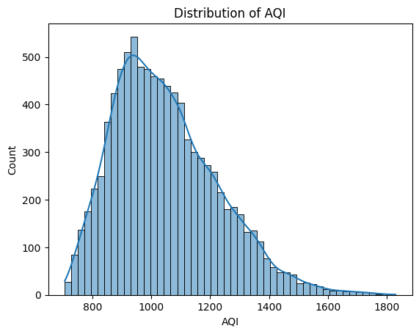
Exploring AQI Data
AQI < 750 Good
AQI <=900 Satisfactory
AQI <= 1050 Fairly Polluted
AQI <= 1200 Poor
AQI >1200 Hazardous
This plot will give us an idea about the distribution of AQI values in the dataset.

Slide 10
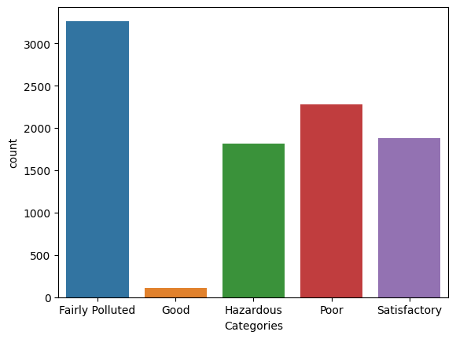
Air Quality Index Distribution per Category
This plot shows us the count of each AQI category in the dataset.

Slide 11
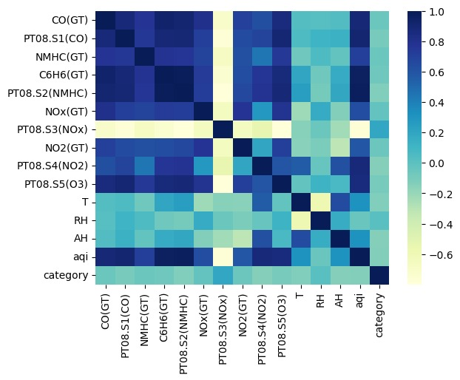
Correlation Visualized using Heat Map
We can notice that the few features are strongly correlated to AQI:
PT08.S1(CO) ,NMHC
C6H6(GT),PT08.S2(NMHC) ,NOx(GT),PT08.S4(NO2) ,PT08.S5(O3) , NO2(GT)

Slide 12
Training Models
Decision tree classifiers :
Hyper parameter- Max_depth, Min_samples_leaf
Accuracy-0.81
K neightbours classifiers
Hyper parameters- N_neighbours , weights
Accuracy- 0.95

Slide 13
Random forest classifiers
Hyperparameters : Max_depth, Max_features, min_samples_leaf, N_estimators
Accuracy- 0.875
SVM – Support vector machine classifier
Hyperparameters- C, kernel, degree
Accuracy- 0.90

Slide 14
Model Performance
Decision Tree 81%
KNN 95%
Random Forest 87.5%
SVM 90.5%

Slide 15
Time series Forecasting
Steps:
Converted date and time columns to date and time format
Resampled data on a daily basis resulting in 391 data points
Decomposed the data to recognize patterns, trends, and seasonality
Conducted Augmented Dickey-Fuller (ADF) test to determine stationarity of the time series
Null hypothesis of ADF test is non-stationarity with a trend, alternate is stationarity without a trend
P-value less than 0.05 (0.046) indicates rejection of null hypothesis and confirms stationarity, the time series is stationary with a 95% confidence level.
Stationary data can be used for fitting a time series model.

Slide 16
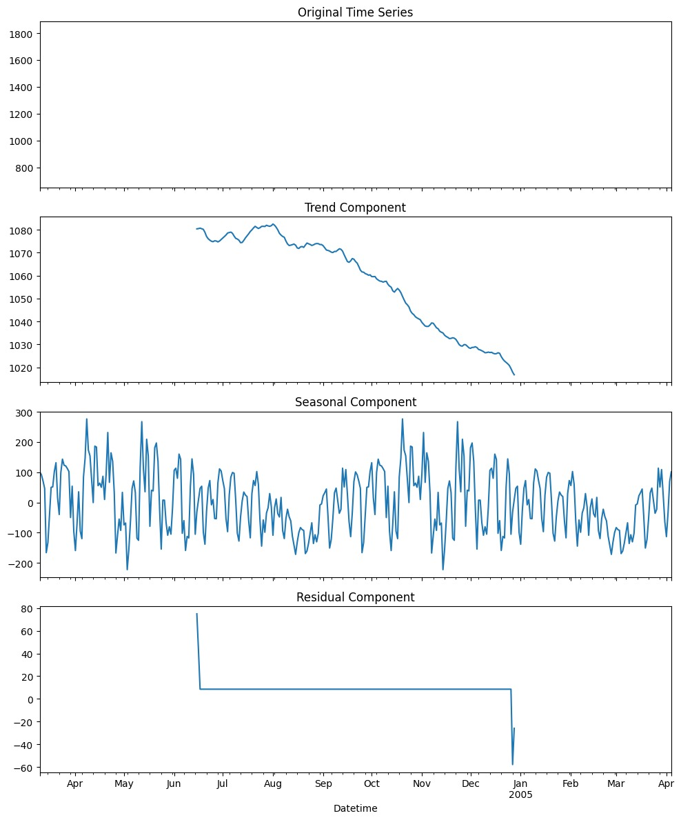
Time series Forecasting

Slide 17
Arima Model
To predict the next 7 days , we used auto arima model which gave us a mean abseloute error of 74.98 and root mean square error of 84.96
These errors are very high in nature as Arima model ARIMA models generally require more data. and we only have data for 16 months which is 391 days. ARIMA models are more complex.
Model is overfitting

Slide 18
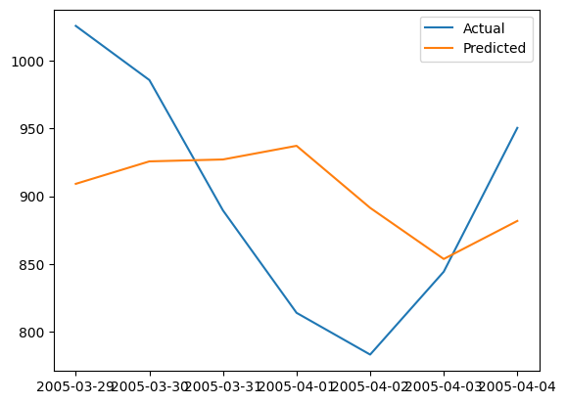
Forecasting Air Quality
ARIMA models and exponential smoothing are the two most widely used approaches to time series forecasting1. An ARIMA model explains a given time series based on its past values.

Slide 19
Exponential smoothening
Exponential smoothing can be effective for time series that have stable patterns, little or no trend or seasonality, and no significant outliers.
Exponential smoothing has fewer parameters to estimate than ARIMA, which can make it easier to select the optimal smoothing parameters.

Slide 20
Exponential smoothening
Exponential smoothing can be effective for time series that have stable patterns, little or no trend or seasonality, and no significant outliers.
Exponential smoothing has fewer parameters to estimate than ARIMA, which can make it easier to select the optimal smoothing parameters
This model resulted in a MAPE 4.51
A MAPE of 4.51% means the model's predictions were off by an average of 4.51% from actual values in the test set.
A MAPE of 4.51% is considered good and indicates the model's predictions are accurate and reliable.
Model performance can be affected by variables, parameters, and modelling decisions.
It's important to evaluate the model using different metrics and compare results before making any conclusions.

Slide 21
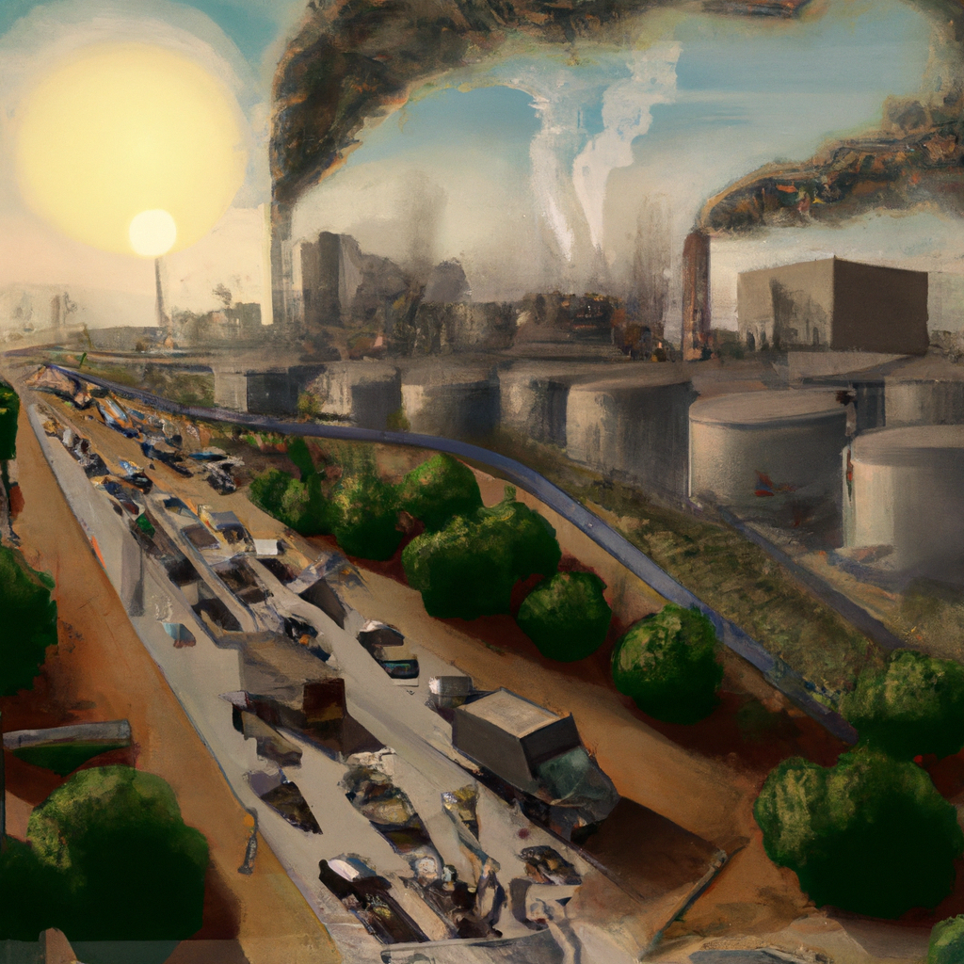
Conclusion:
These are the forecasted values for next 10 days
1131.749929
1078.957425
1045.808006
1058.827633
1028.478679
1004.824410
989.769654
1009.110220
1112.439036
1135.527800
In this analysis, we explored the air quality index (AQI) data of a city in Italy.
We found that the average AQI levels were moderate, with occasional spikes in pollution.
Overall, this analysis highlights the need for continued monitoring and mitigation efforts to improve air quality and protect public health in the city.

